Slide 1
Companies Leaving or Staying in Russia Following Invasion of Ukraine
Travis Lindeman

Slide 2
Agenda
Stakeholder Interest
Data of Interest
Compare Company Activity following invasion of Ukraine
Type of Industry
Country of Origin
Scale Comparison
Way Forward

Slide 3
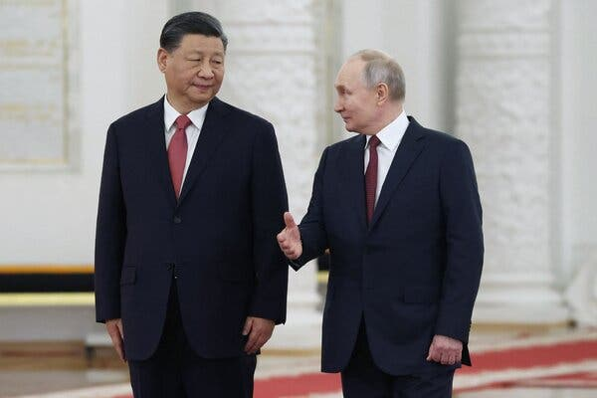
Stakeholder Interest
Evaluate whether specific industries are unable/unlikely to divest
Inform future negotiation strategies
Assess significant disparities to determine vulnerable companies for sanctions strategies
Notes:
Image from Sputnik, via Agence France Presse and accessed from The New York Times JUL 11th, 2023 at: https://www.nytimes.com/2023/07/06/opinion/xi-putin-relationship-china.html

Slide 4
Dataset
Company Name
1581 Companies
Actions taken since the Invasion
Company Industry:
12 categories
Country of Origin:
67 represented
Grade:
A, B, C, D, F
Sample
Name | Action | Industry | Country | Grade
China Mobile | Business as usual | Communications | China | F
Guess | Business as usual | Consumer Discretionary | United States | F
TEPCO | Continues purchasing Russian Gas | Energy | Japan | F
WeWork | Planning Divestment of Russian Operations | Real Estate | United States | A
Uber | Divest Yandex Partnership | Information Technology | United States | A
Data aggregated by researchers at the Yale Chief Executive Leadership Institute
Notes:
Action & Letter grade are subjective measures.

Slide 5
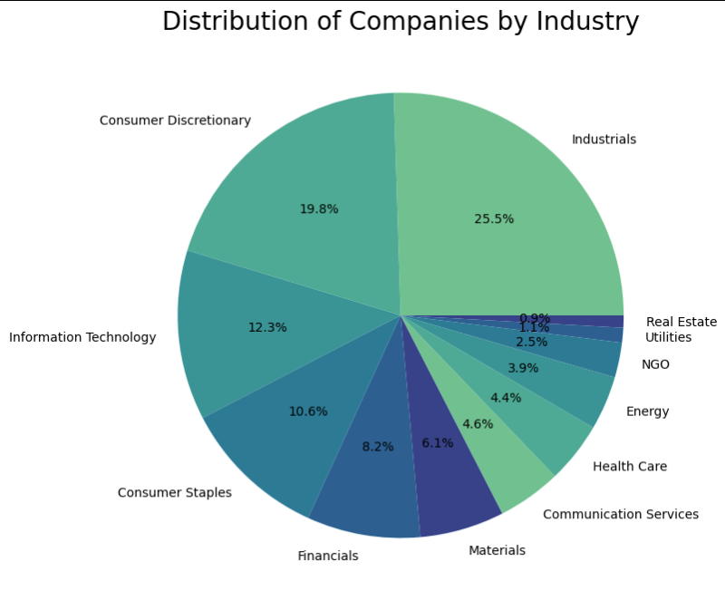
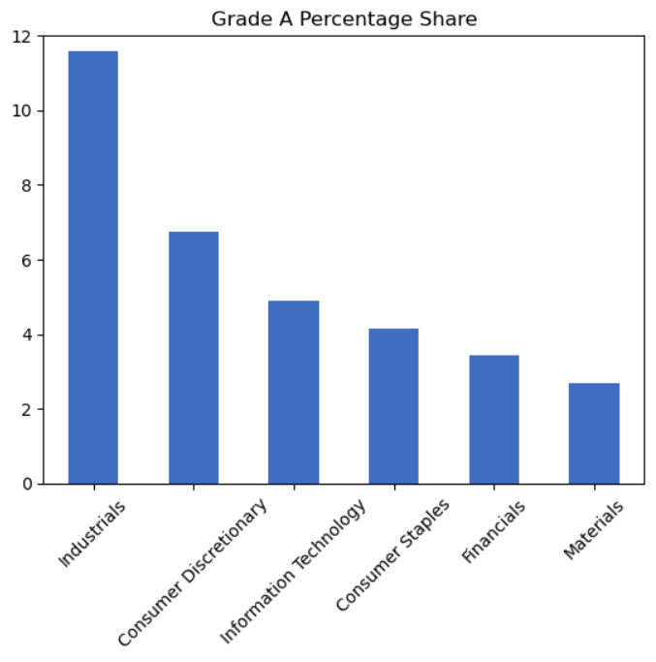
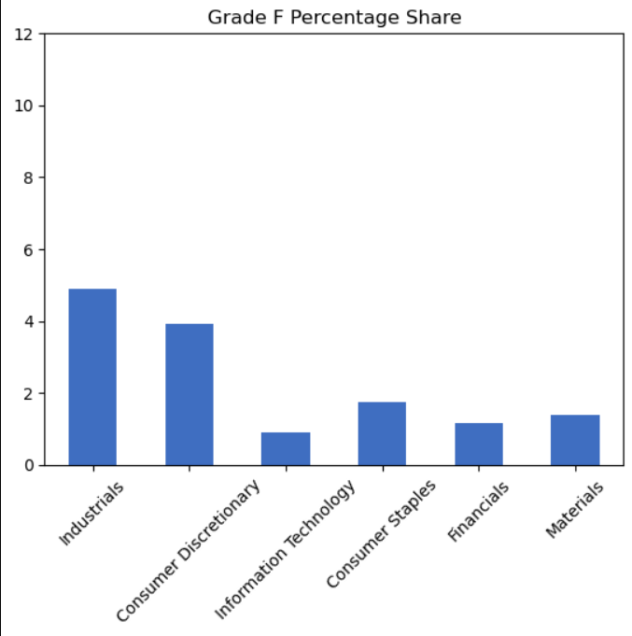
Comparison by Industry:
All Industries
Six Biggest Industry Comparison (82.5% of the Total)
Industry comparison does not show significant differences

Slide 6
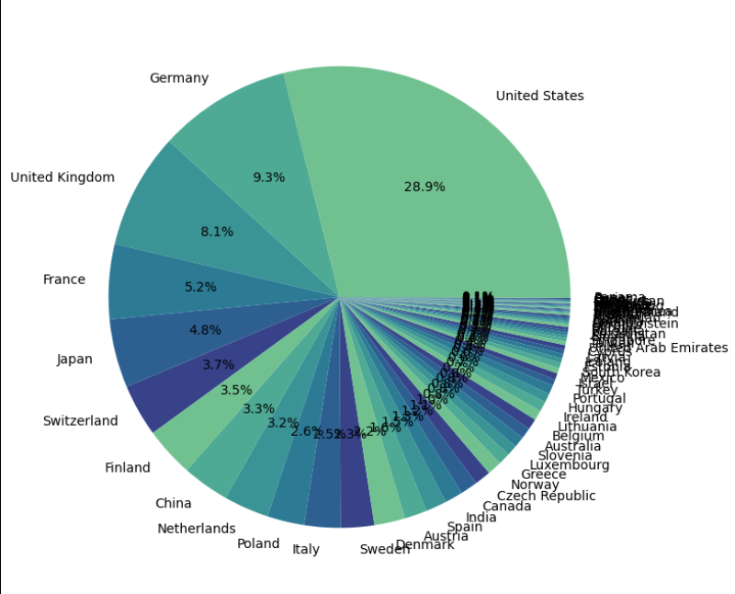
Comparison by Country of Origin
United States:
457 companies
United Arab Emirates:
4 companies

Slide 7
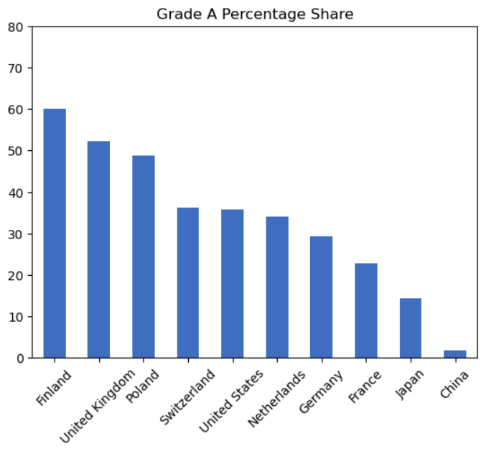
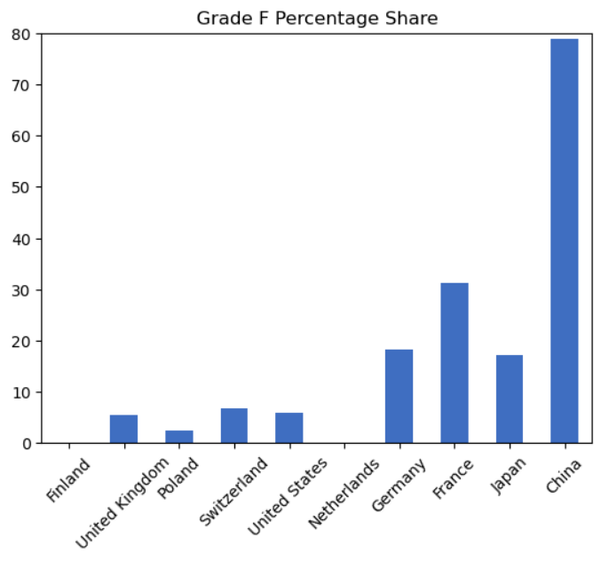
Comparison by Country of Origin: 10 Countries with the Most Companies in Russia
Reflected by “no-limit” partnership between China & Russia.
Reflected by President Macron’s statement about “getting caught up in crises that are not ours” and “strategic autonomy.”
Geopolitical positions correlate with company operations in Russia

Slide 8
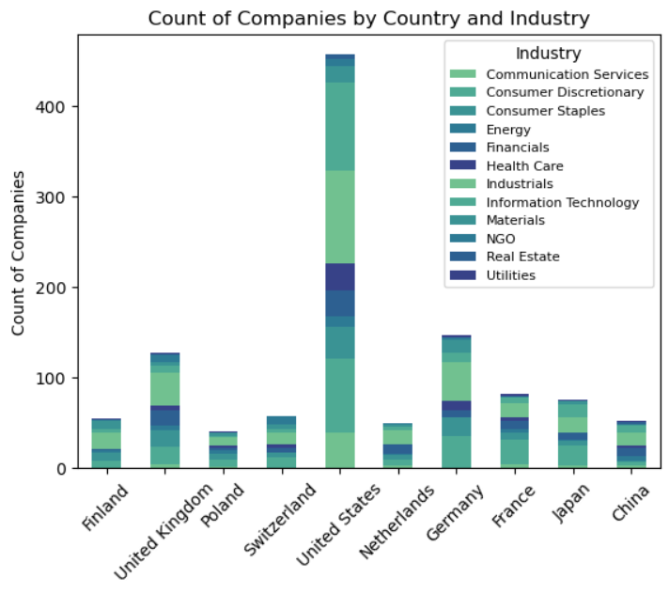
Scale Comparison with Total of all Companies
F Grades account for 41 Chinese, 26 French, and 27 U.S. companies
Notes:
China may be under represented. However, Finland and China have almost the same number of companies and are opposites in their received grades.

Slide 9
Future Project Plans
Comparison by “Global South” countries such as Brazil, South Africa, Turkiye, Indonesia, China to see if the “unaligned global south” demonstrates less interested in divestment
Look for correlations on whether or not companies are state owned enterprises to see if there is a significant disposition to stay or leave

Slide 10
Contact and Data Links
Contact Info:
Travis Lindeman
tralinde@gmail.com
Repository link:
https://github.com/tralinde/companies_in_russia
Dataset link:
https://www.kaggle.com/datasets/vadimtynchenko/list-of-companies-leaving-or-staying-in-russia

